Slide 1
Transmission Line Parameters

Slide 2
Transmission Line
Transmission line is the long conductor with special design (bundled) to carry bulk amount of generated power at very high voltage from one station to another as per variation of the voltage level.

Slide 3
Types of Transmission Line
In transmission line determination of voltage drop, transmission efficiency, line loss etc. are important things to design. These values are affected by line parameter R, L and C of the transmission line. Length wise transmission lines are three types.

Slide 4
Short Transmission Line
A short transmission line is classified as a transmission line with:
A length less than 80km (50 miles)
Voltage level less than 69 kV
Capacitance effect is negligible
Only resistance and inductance are taken in calculation capacitance is neglected.

Slide 5
Medium Transmission Line
A medium transmission line is classified as a transmission line with:
A length more than 80 km (50 miles) but less than 250 km (150 miles)
Operational voltage level is from 69 kV to approx 133 kV
Capacitance effect is present
Distributed capacitance form is used for calculation purpose.

Slide 6
Long Transmission Line
A long transmission line is classified as a transmission line with:
A length more than 250 km (150 miles)
Voltage level is above 133 kV
Line constants are considered as distributed over the length of the line.

Slide 7
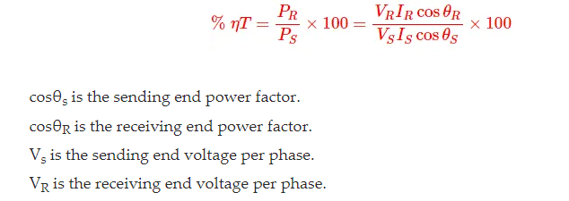
Efficiency of Transmission Line
Transmission efficiency is defined as the ration of receiving end power P_{R} to the sending end power P_{S} and it is expressed in percentage value.

Slide 8
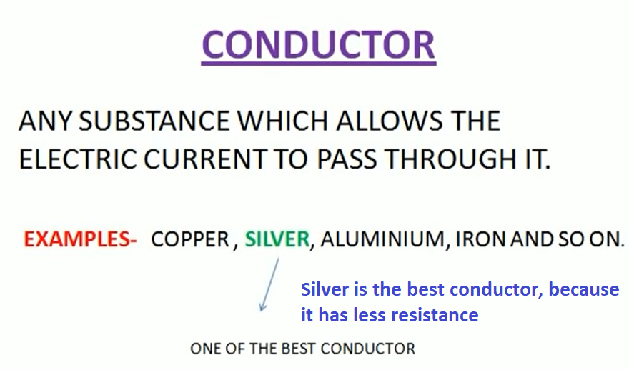
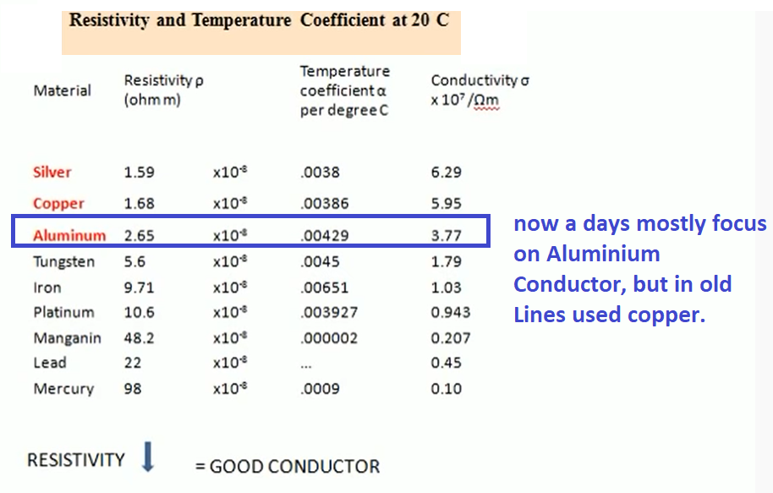
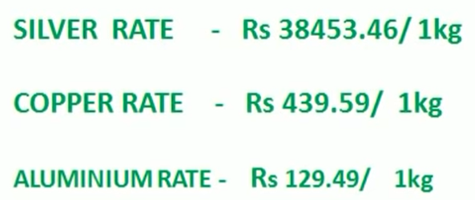
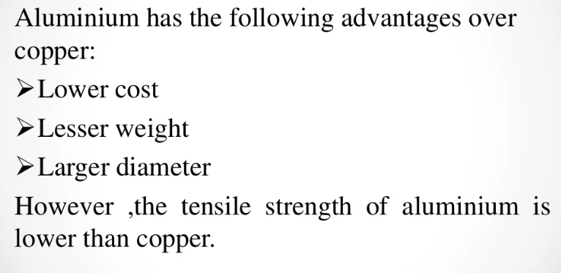

Slide 9
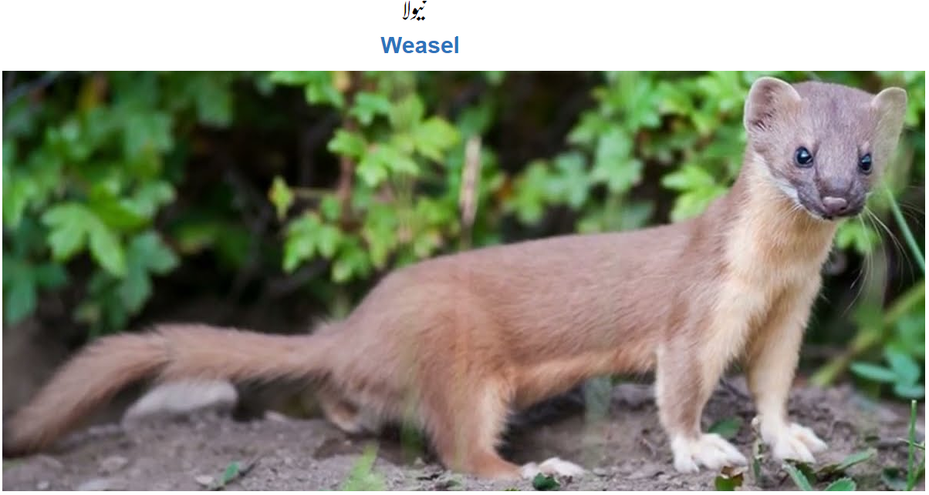
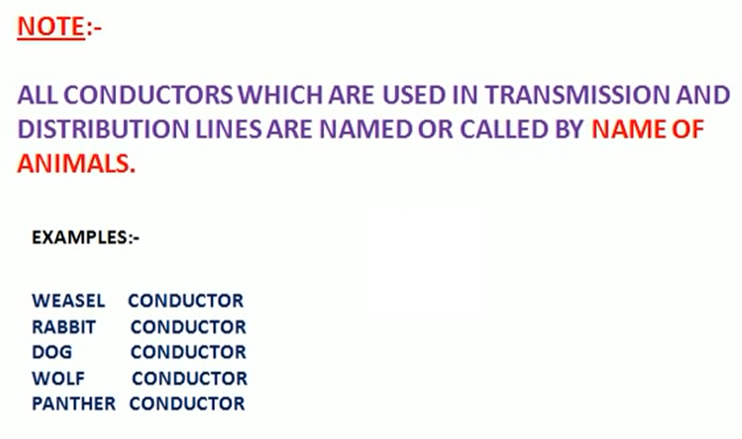

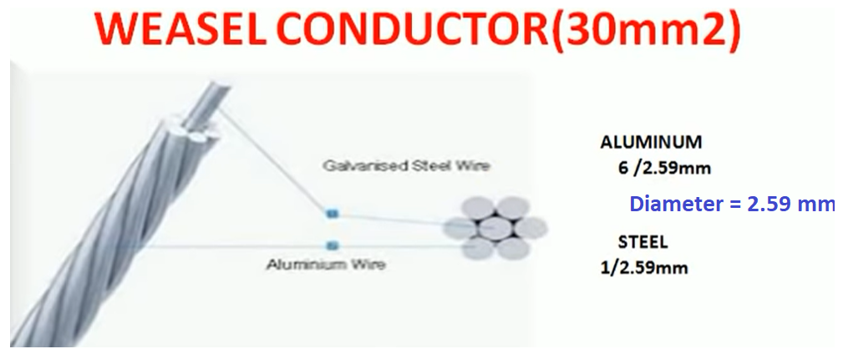

Slide 11
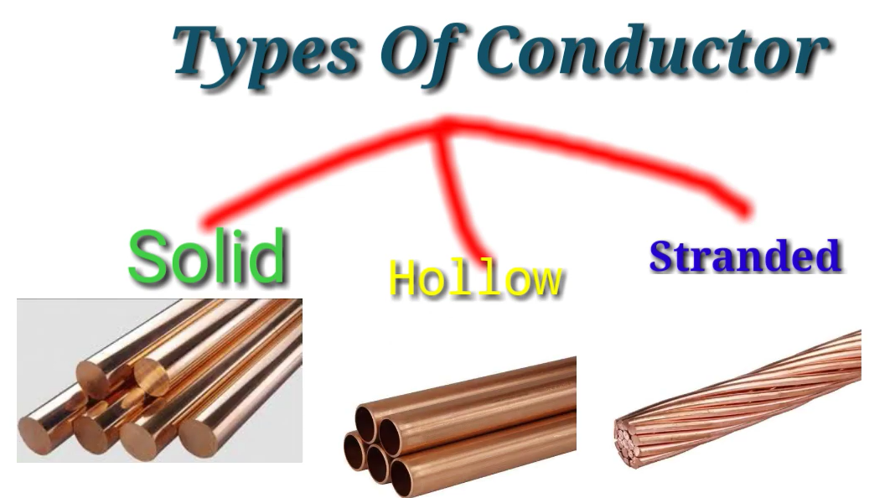

Slide 12
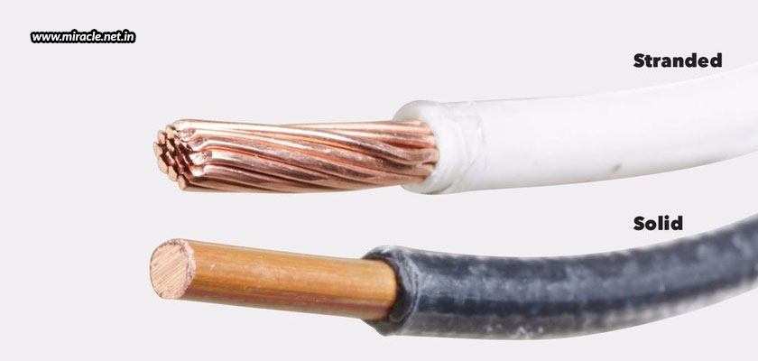
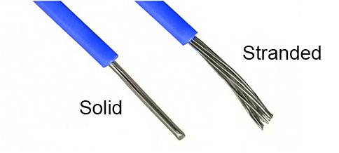
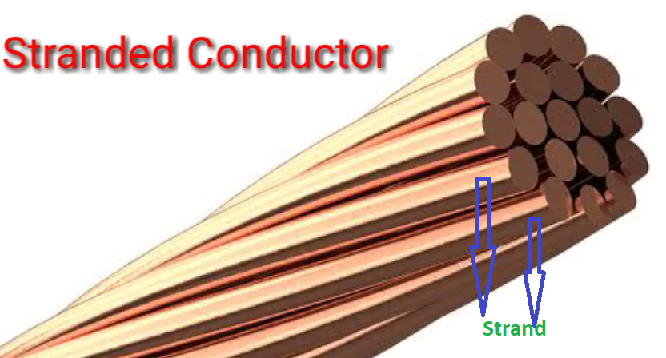
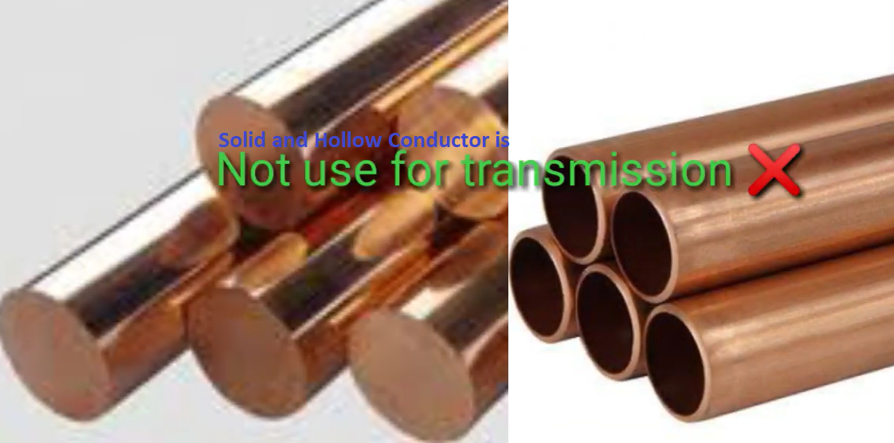

Slide 13
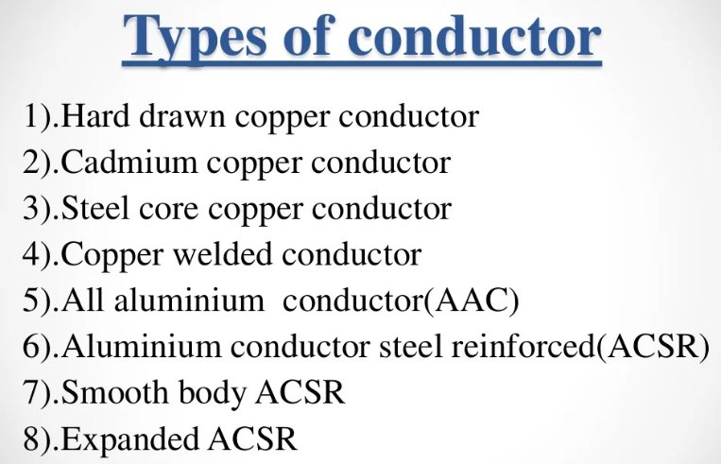

Slide 14
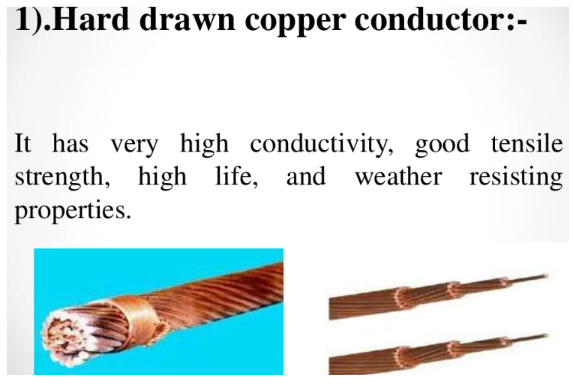

Slide 15
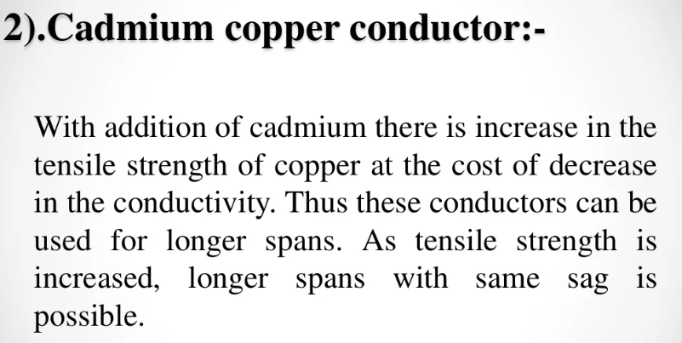

Slide 16
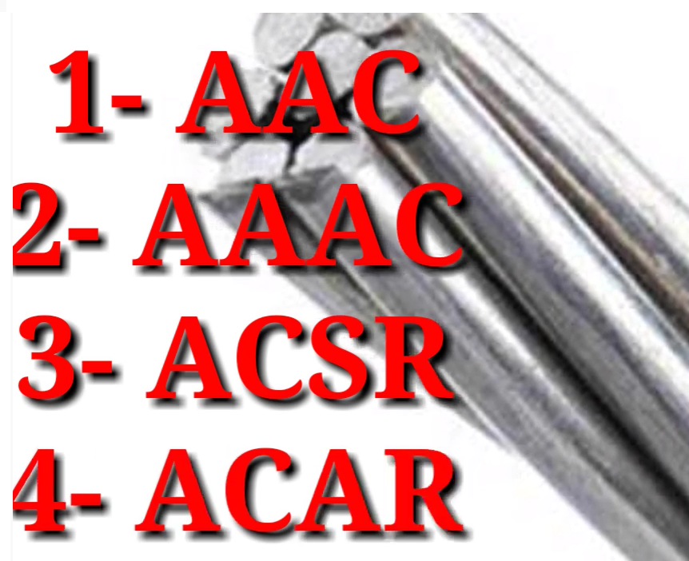

Slide 17
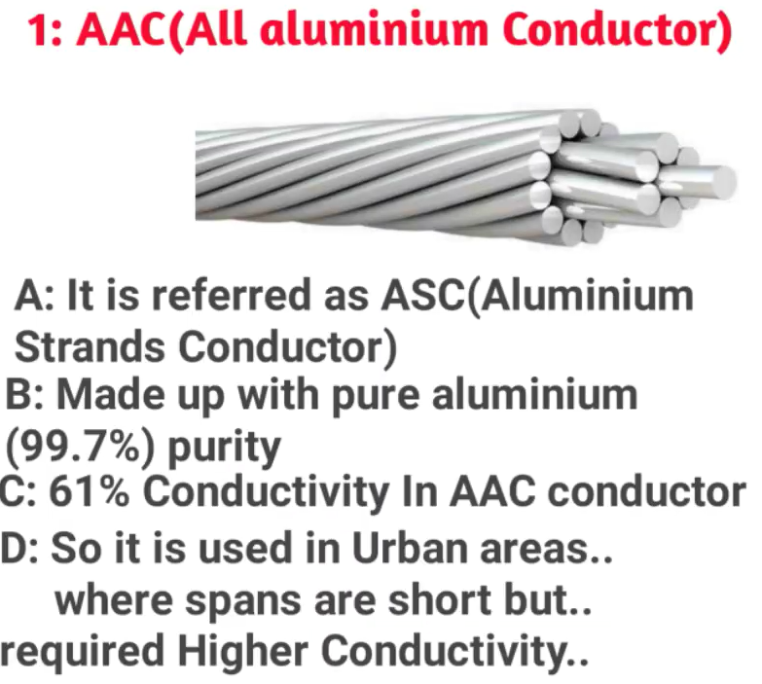

Slide 18
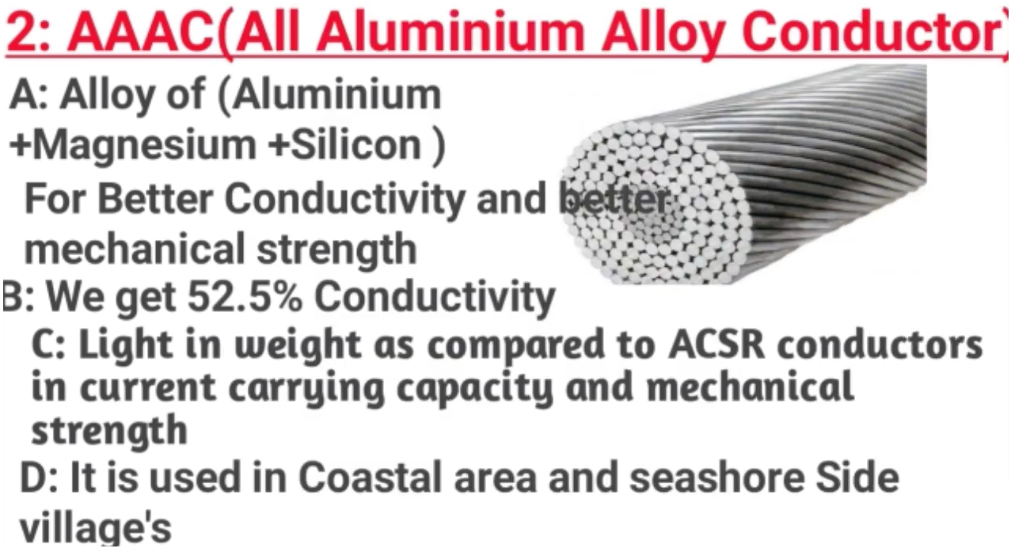
(reduce to moisture on the coastal side)

Slide 19
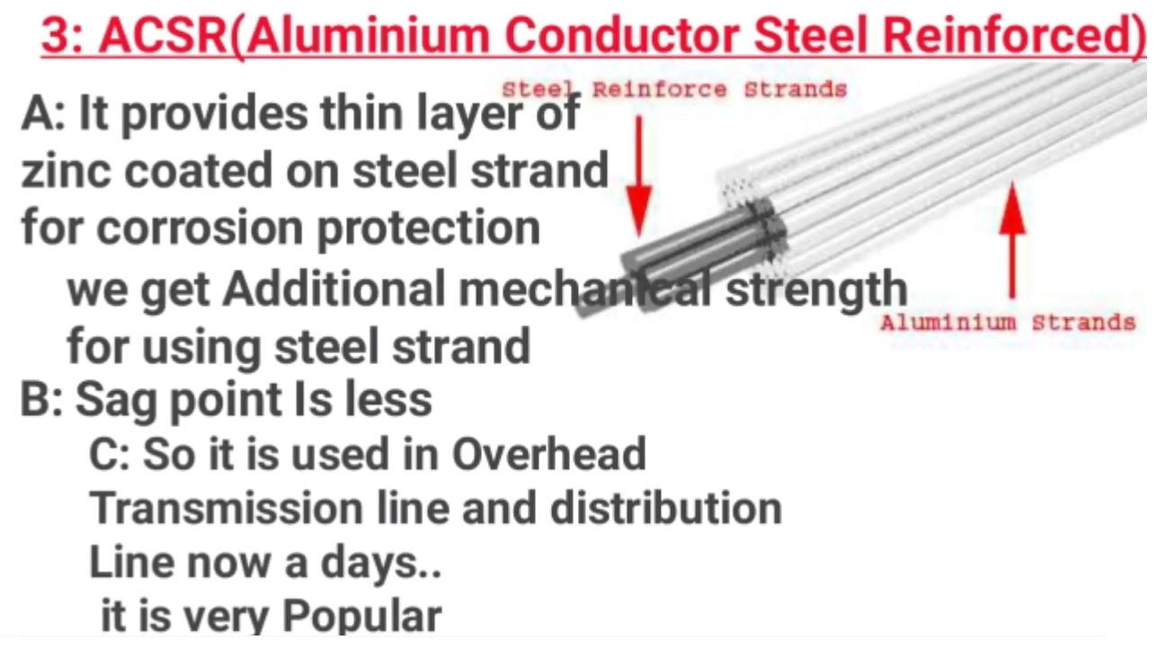

Slide 20
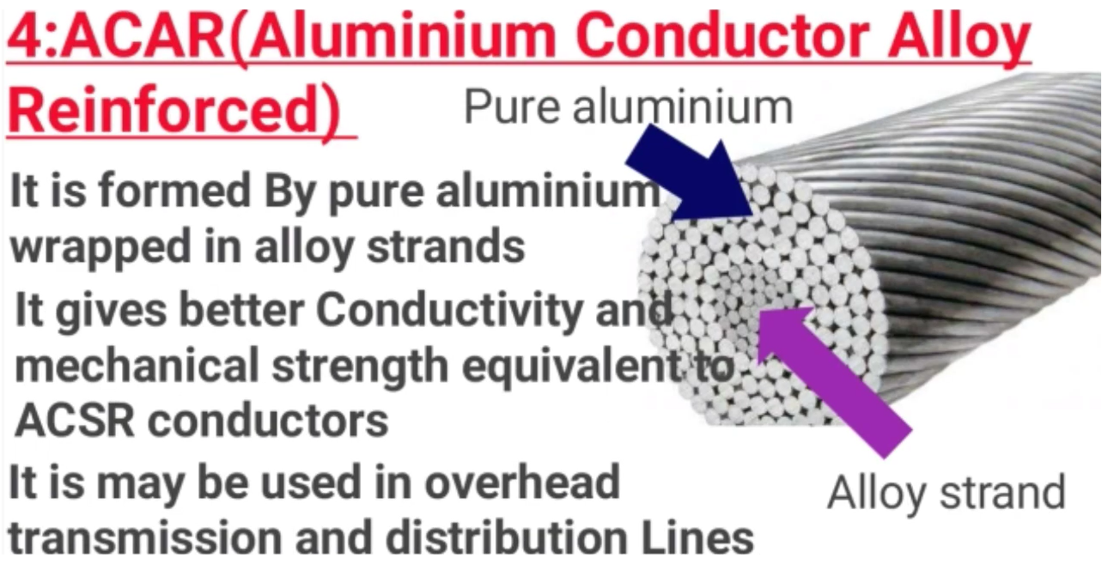

Slide 21
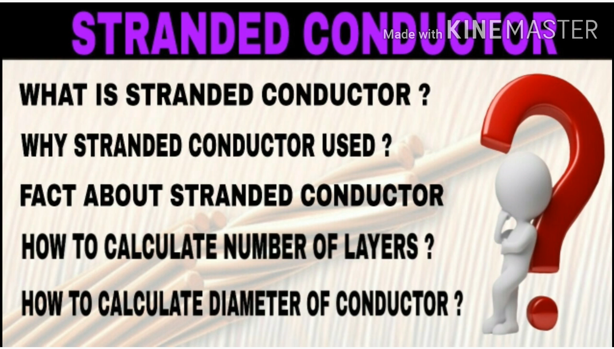

Slide 22
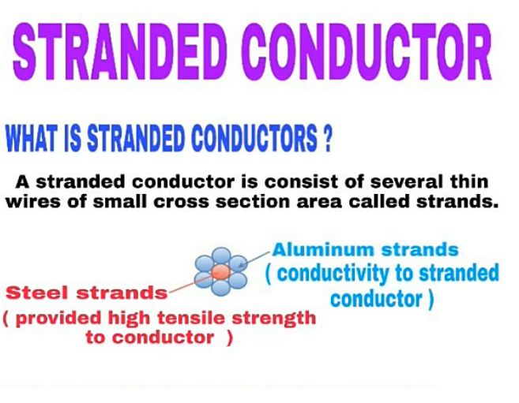
STRANDED CONDUCTOR
Stranded Conductor is consist of several thin wires of small cross section area called Strands

Slide 23
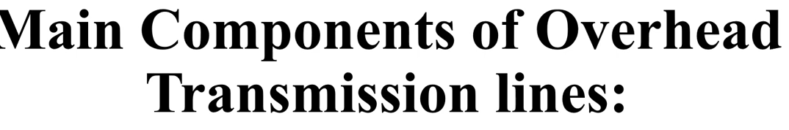
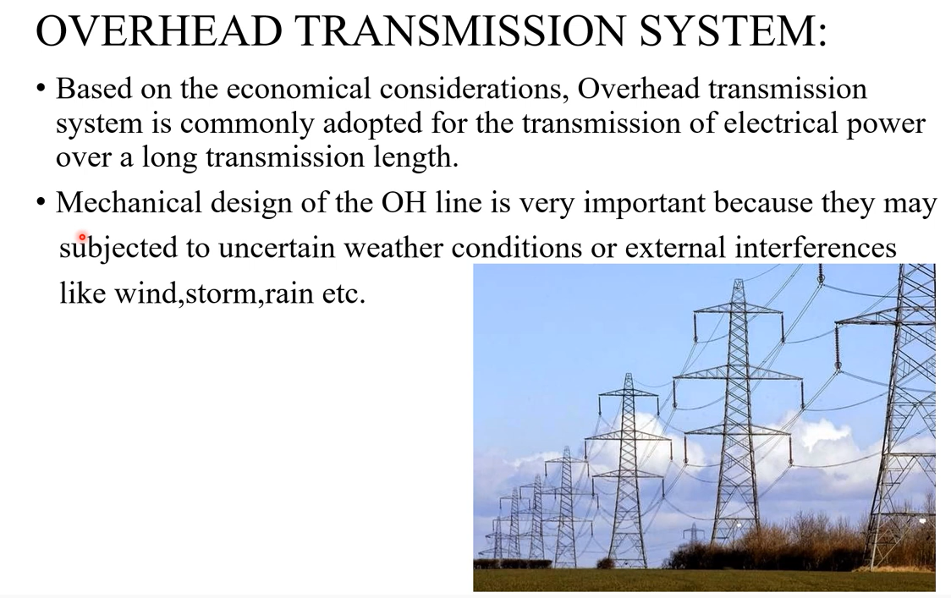

Slide 24
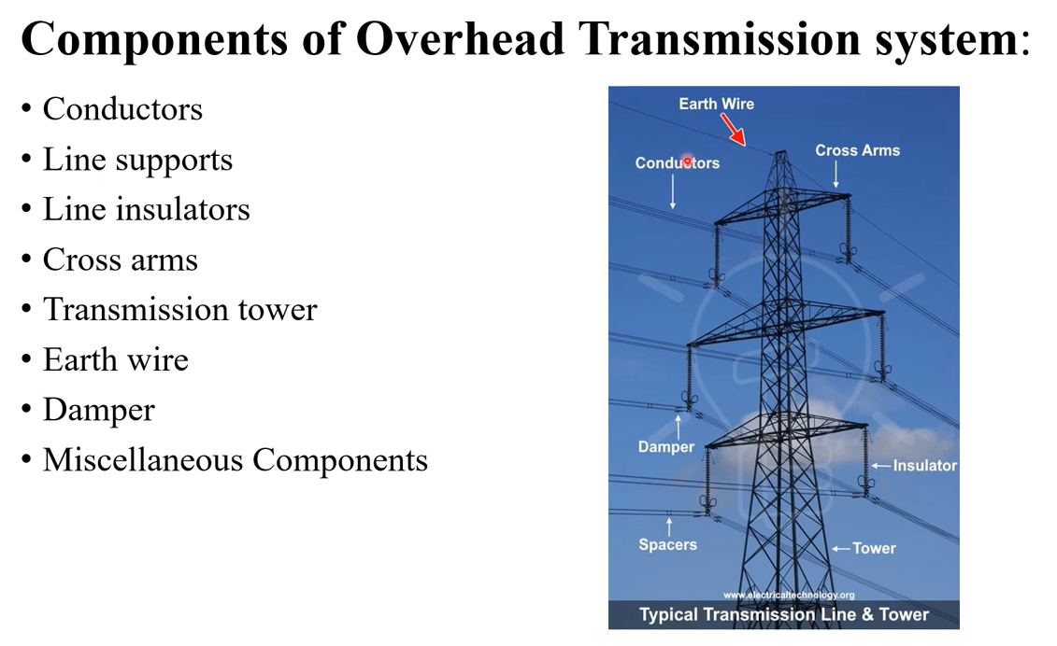

Slide 25
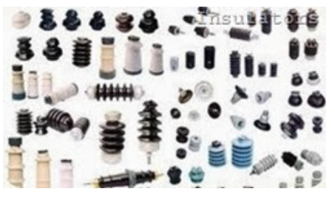
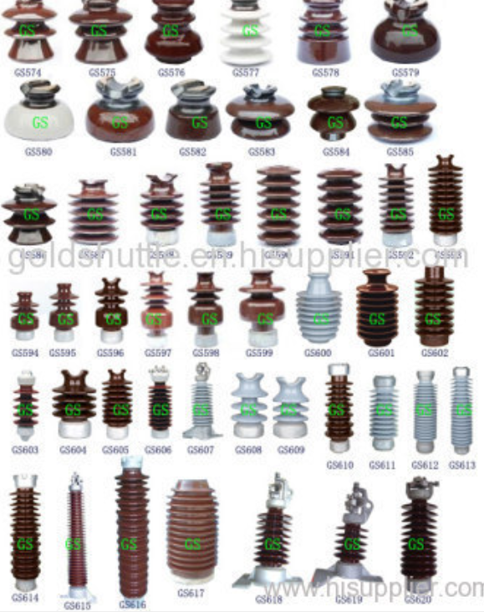
INSULATORS
Insulator is a material in which the current can not flow easily.

Slide 26
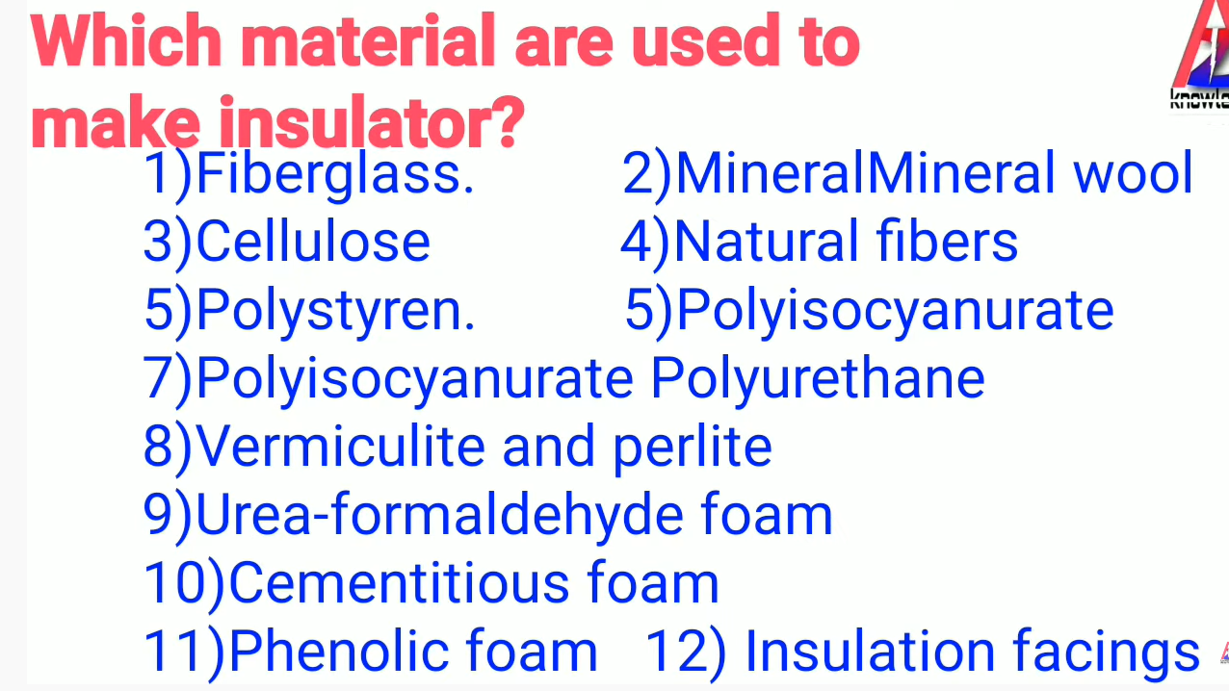
Materials Used to Make Insulator
Fiberglass

Slide 27
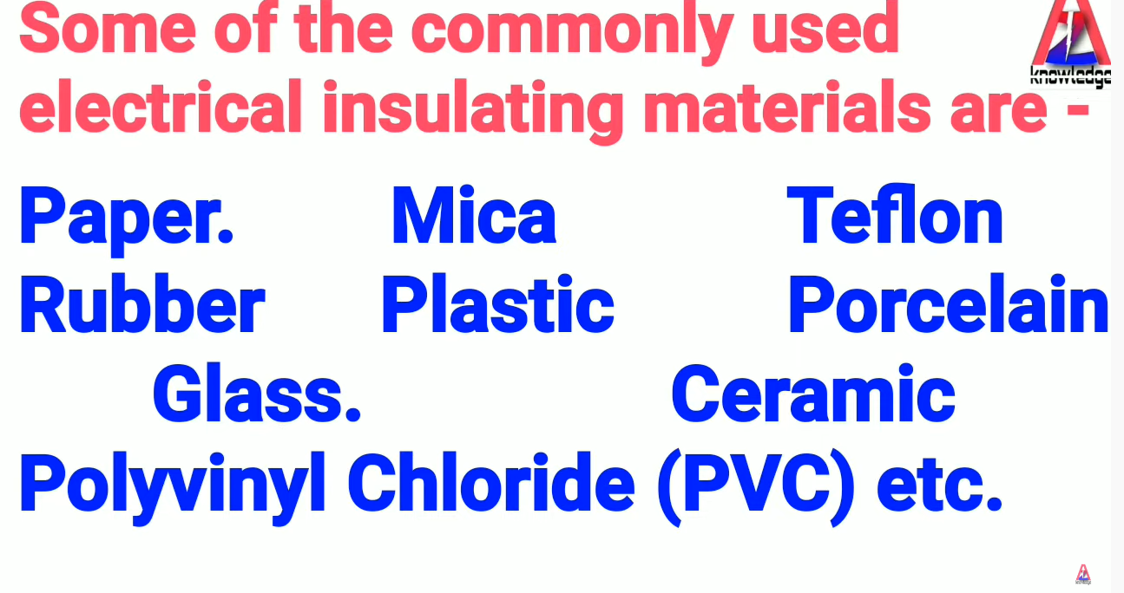

Slide 28
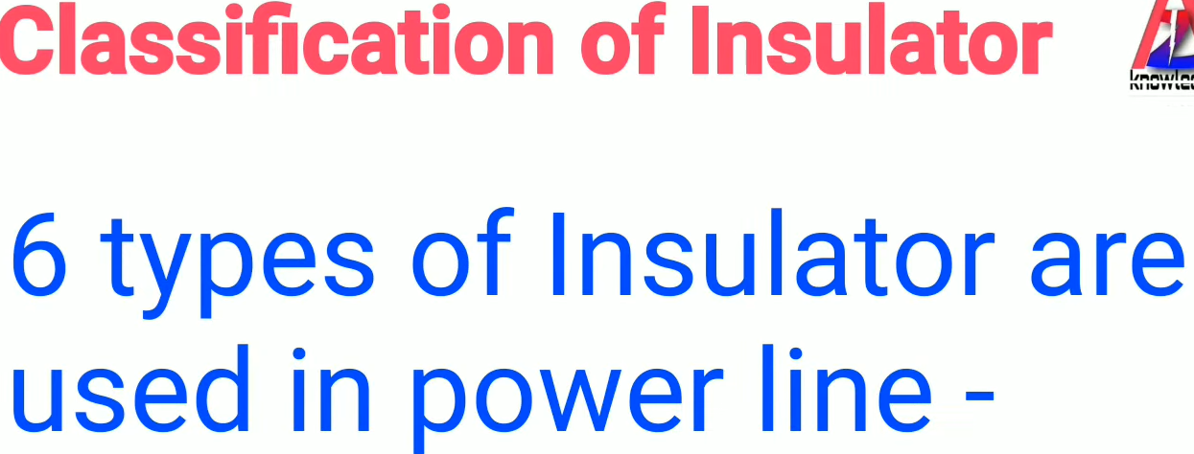

Slide 29
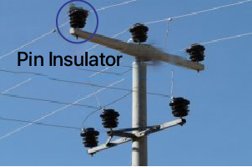
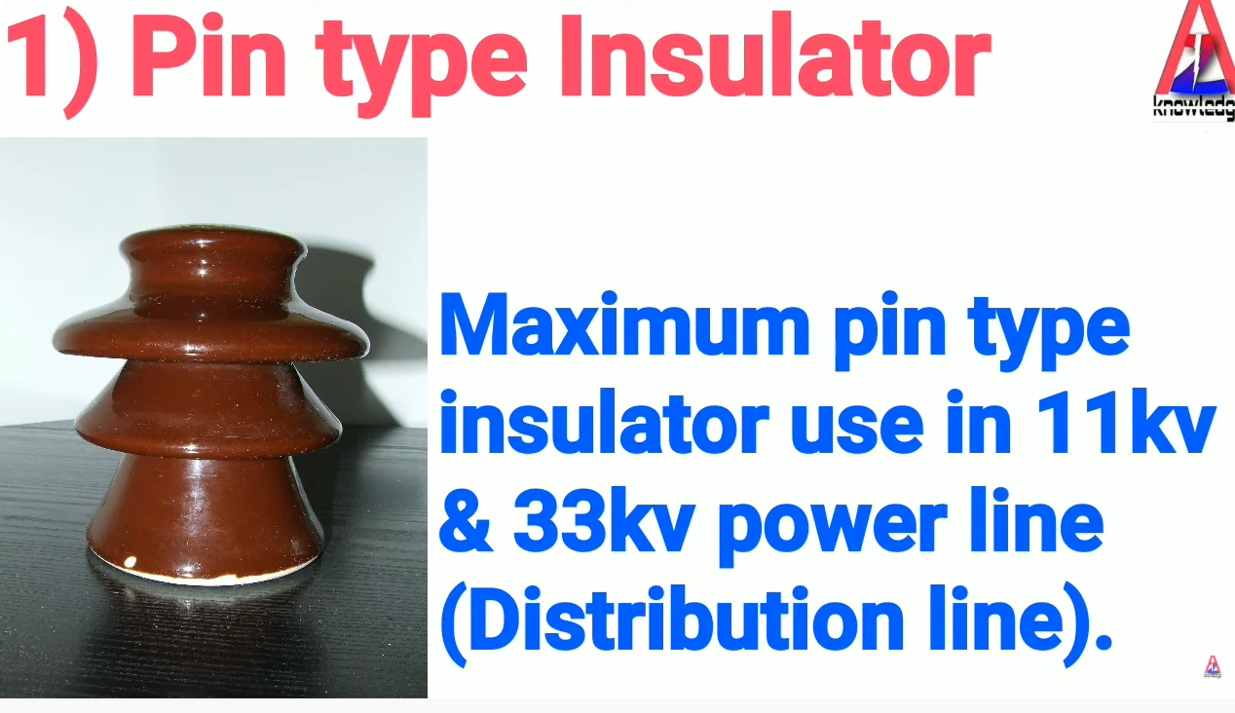

Slide 30
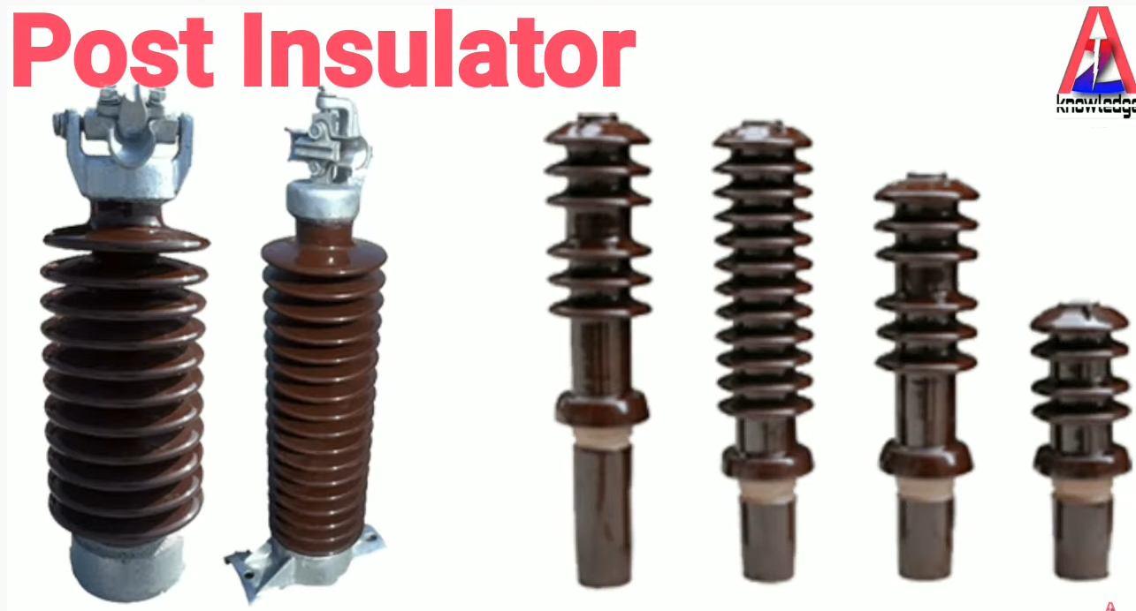

Slide 31
Post Insulator
Post insulators are used as supports for bus-bars in transformer sub-station yards, in switchgear as support for breakers, and for capacitor banks.
These insulators are generally subjected to bending, torsion and compression forces in service. In some cases they may also be used as jumper loop insulators for horizontal, upright or underhung installation. Depending on the installation, we offer several options of end fittings. Designs according to IEC, ANSI and other standards or to customer specification.

Slide 32
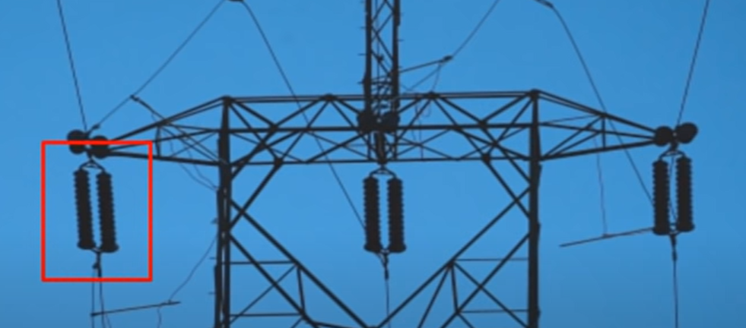
DISK INSULATORS

Slide 33
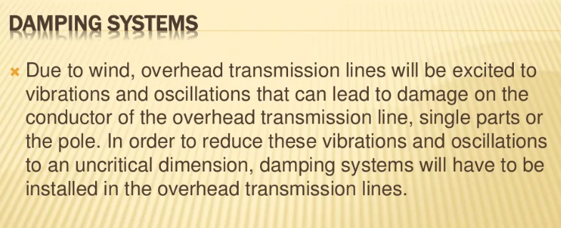
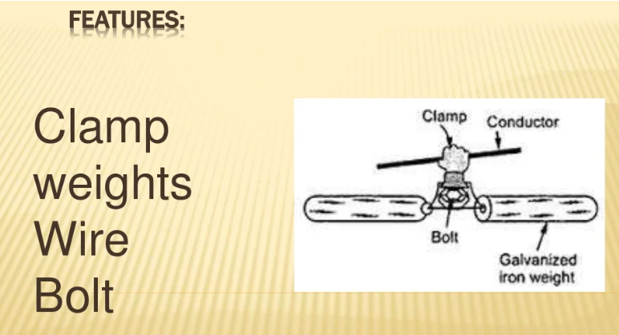

Slide 34
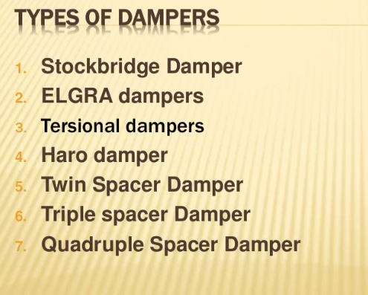

Slide 35
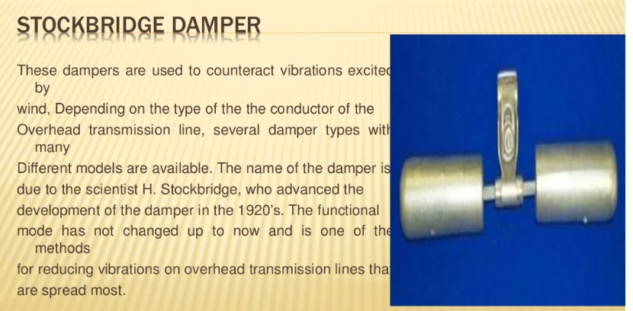
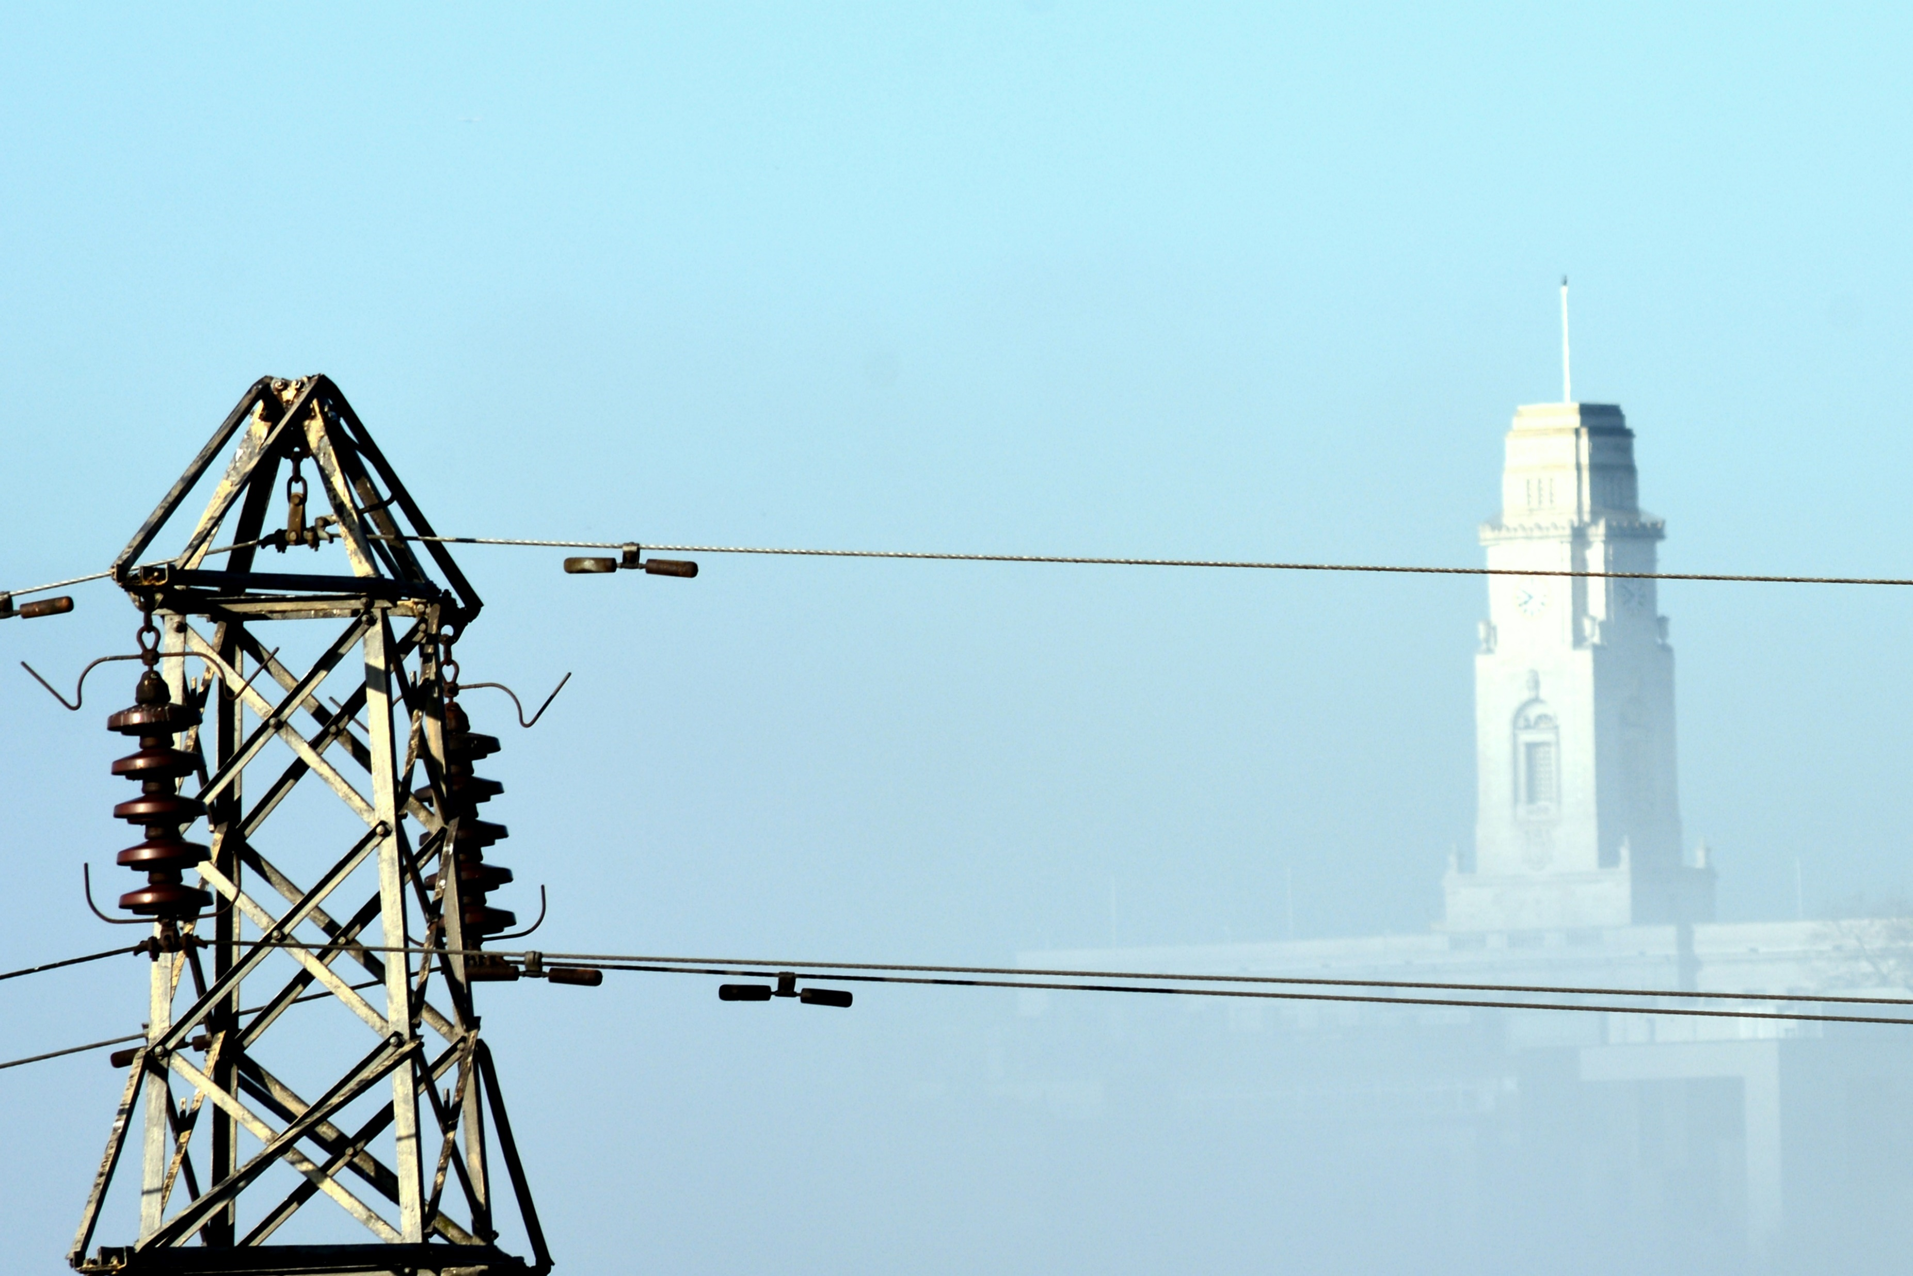

Slide 36
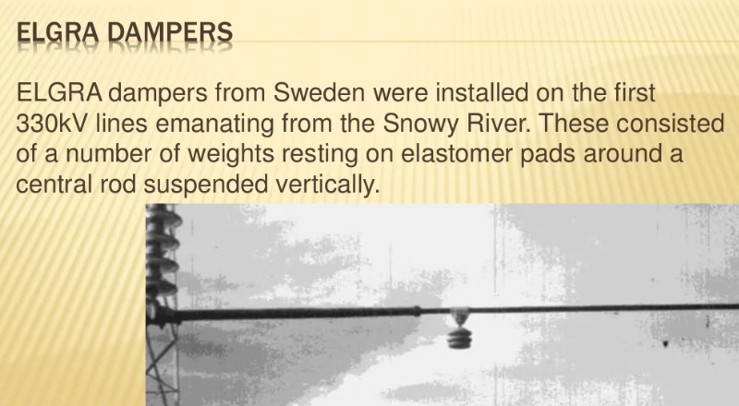

Slide 37
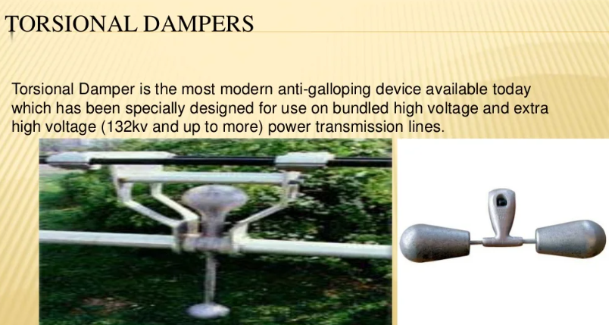

Slide 38
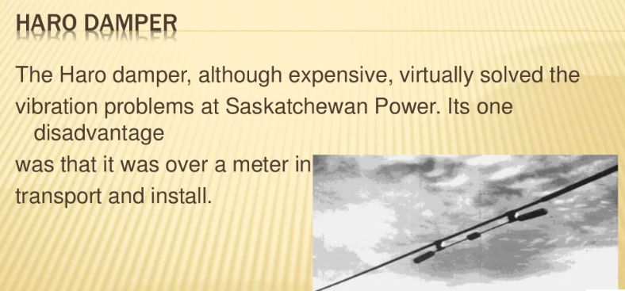

Slide 39
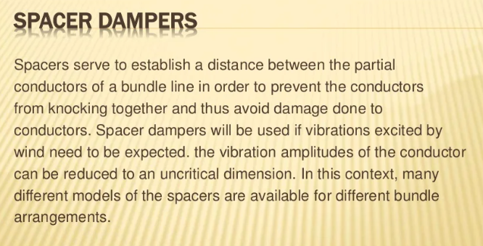

Slide 40
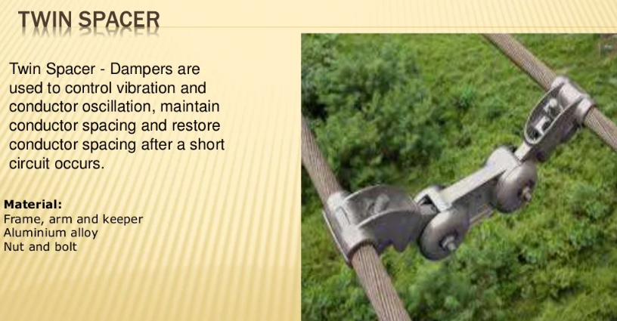

Slide 41
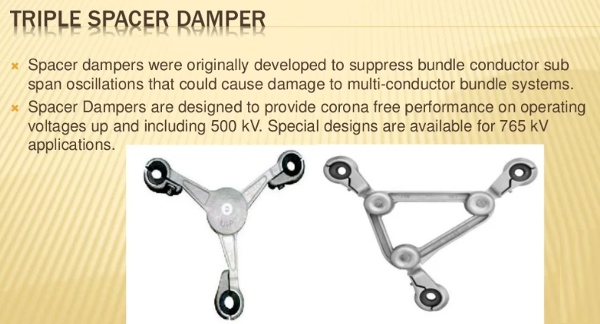

Slide 42
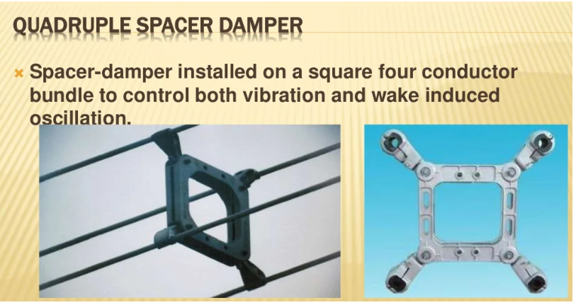
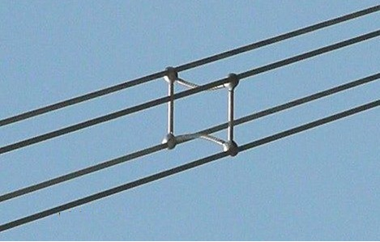
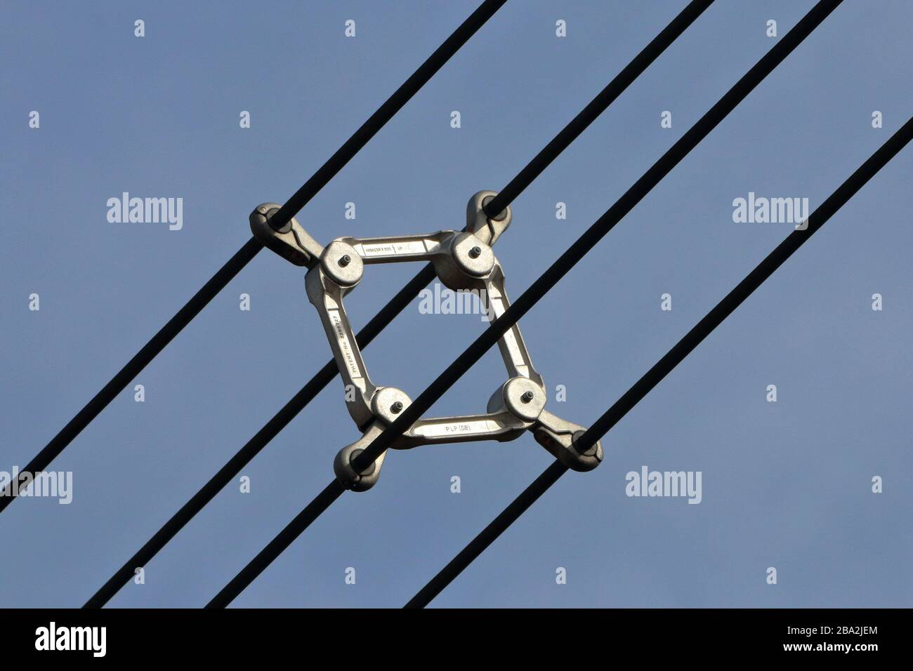

Slide 43
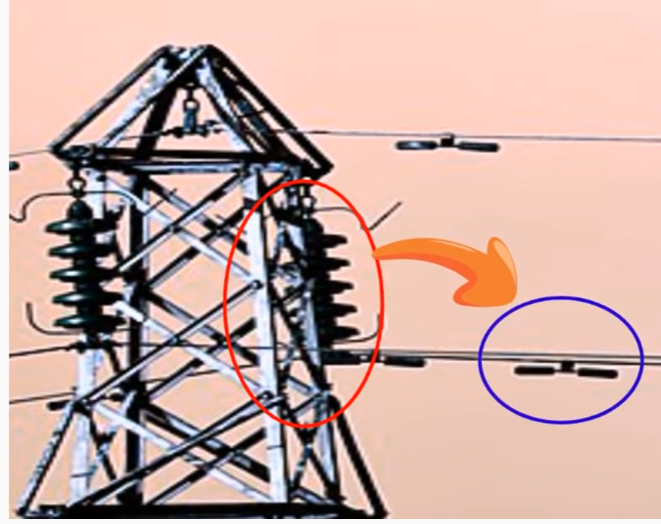

Dampers
Dampers are used to Control the Vibrations in Overhead Transmission Lines.

Slide 44


Slide 45


Slide 46
Galloping Or Dancing of Conductor
When wind speed is higher than normal wind speed than conductor start dancing.
In this case Frequency is low, but Amplitude is too high.
Such type of vibration is called Galloping Vibration or Dancing of the Conductor.

Slide 47


Breaking the Stranded Conductors

Slide 48

Inductance of 3-Phase Line With Symmetrical Spacing

Slide 49



Transposition Of Conductor
The physical position of overhead conductor changes after fixed distance is known as Transposition of Conductor.
Main purpose is to Transmit the equal voltage from each phase.
Always Upper conductor shift to the Center

Slide 50



Reason Behind the Transpose of Conductor
Suppose a 3-phase overhead conductor and high voltage power is is transmit through this conductor.
We already know when current flow in a conductor than a magnetic field create around a conductor.
But middle conductor create a more field due more flux linkage as compare to other two conductors.

Slide 51


More Power Loss in Middle Conductor
More Power Loss in a Middle Conductor, due to large flux linkage and resistance will greater than other two conductor.
As a result, at receiving end unequal voltage will transmit.
To resolve this issue and transmit the equal voltage from each phase we us ethe Transpose Conductor Technique.
Main disadvantage is to increase the overall cost of the Conductor.

Slide 52






Slide 53


Slide 54
https://www.youtube.com/watch?v=BE8_DehnbPc&list=PPSV
https://www.youtube.com/watch?v=NsL56gvWXC4
https://www.youtube.com/watch?v=lihwb4PRQAs
https://www.youtube.com/watch?v=GmsRQzVfEZQ

Slide 55


